Slide 1
Bandwidth Requirement & State Consistency in Three Multiplayer Game Architectures
Joseph Pellegrino - University of Delaware
Constantinos Dovrolis - Georgia Tech

Slide 2

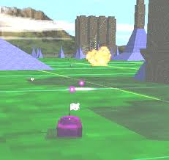
BZflag

Slide 3
Overview
Review two existing gaming architectures:
Client-Server (CS)
Peer-to-Peer (PP)
Evaluate two key factors:
Bandwidth requirement at players/server
State consistency resolution mechanism & latency
Introduce a new architecture:
Peer-to-Peer with Central Arbiter (PP-CA)
Experimental results using BZflag

Slide 4
Existing Architectures
Client-Server (CS)
Simpler state consistency resolution
Low client bandwidth requirement
Server: single point of failure
High bandwidth requirement @ server (scalability issue)
Server increases communication latency
Peer-to-Peer (PP)
Lower communication latency
Distributed state consistency resolution
Requires clock synchronization
Less admin-control for subscription, anti-cheating, etc

Slide 5
Proposed Architecture
Peer-to-Peer with Central Arbiter (PP-CA)
Simple consistency resolution (as in CS model)
Remove server’s bandwidth bottleneck
Avoid extra communication delay of CS model

Slide 6
State Consistency Resolution
State S_{i}(t): set of all game attributes as seen by player i at time t
Ideally, all players should have same state at all times:
Network latency prevents ideal state consistency
Goal: minimize duration of inconsistency between any two players
T_{I}: Maximum Inconsistency Period (MIP)

Slide 7
Components of Inconsistency Resolution Period
Player Loop:
Read input, receiving updates, compute local view, rendering
Loop duration: Player Update Period = T_{U}
T_{U} is fairly stable at same machine
Server Latency:
Read player update, check consistency, relay update to all players
Round-Trip Time (RTT):
Minimum network latency between player and server (without any client or server latency)

Slide 8
Experimental Methodology
Experiments were conducted using BZflag
Multiplayer open-source 3D tank battle game
Developed in 1992
Uses client-server model/multicast if available
No state consistency provided
Pentium-III based PCs
Redhat Linux 7.0
Fast Ethernet switch
Four players – 10 minute game – 10000 transactions

Slide 9
Modifications to BZflag
Original implementation: CS with “smart clients”
No consistency resolution
Created PP implementation
Easy to do with smart clients
Implemented PP-CA architecture
Include state consistency checks at server/CA
Make sure that players do not occupy same position
Expand headers with timestamps to measure RTT and inconsistency resolution latency

Slide 10
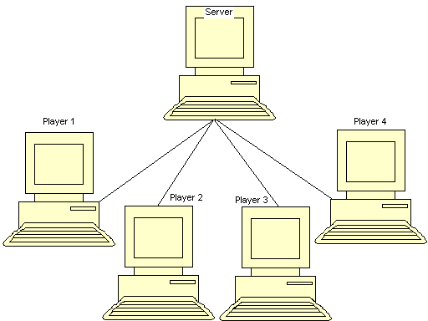
Client-Server Architecture
Server distributes updates between players
Server maintains global state
Server resolves any inconsistencies by accepting/rejecting player updates

Slide 11
CS Bandwidth Requirement
Players send an update (L_{u}) to server in every update period T_{u}
Server relays updates to each of the N players in every update period
Player bandwidth requirement:
Server bandwidth requirement:
Key point: server bandwidth requirement increases quadratically with number of players

Slide 12
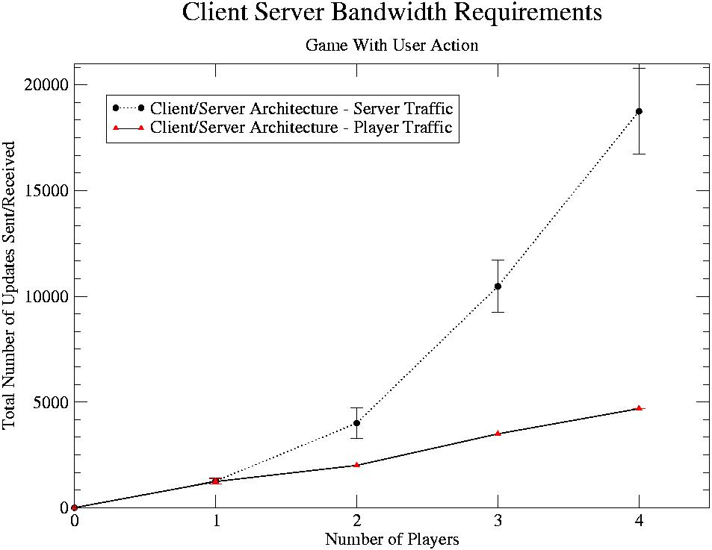
Bandwidth Measurements at Server
Bandwidth at server increases quadratically with number of players

Slide 13
Consistency Resolution in CS
Server receives updates from all players
Server compares requested moves to current state
Build consistent new global state, and return update to players
MIP: T_{I} = max_{i}{T_{U} + T_{S} + R_{i,S}}

Slide 14
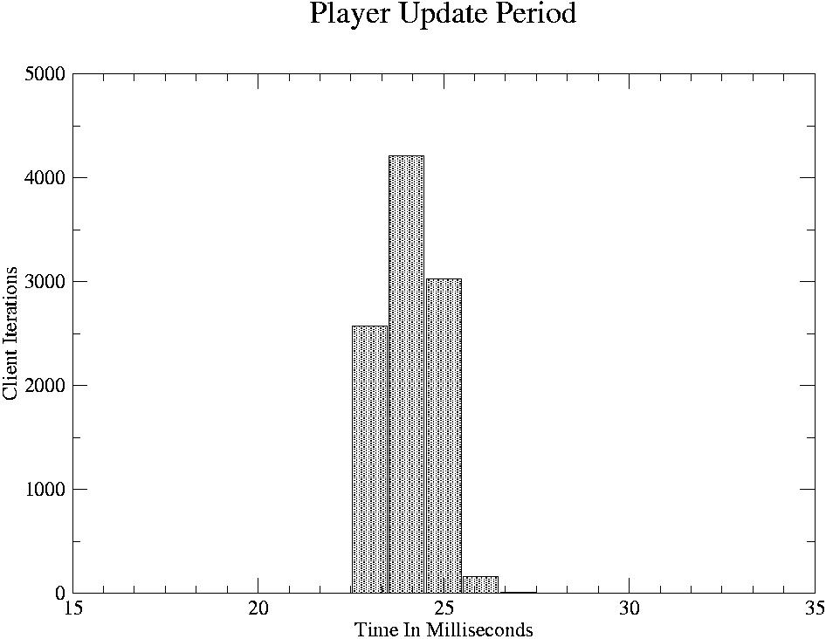
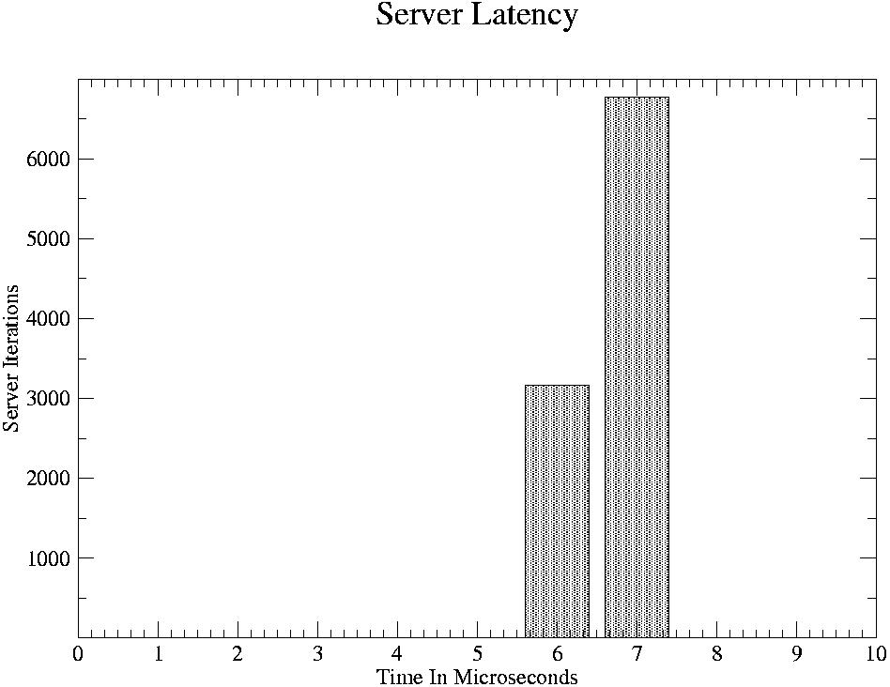
BZflag Measurements
Player Update Period: 24-26 ms
Server Latency: 6 – 8 μs

Slide 15
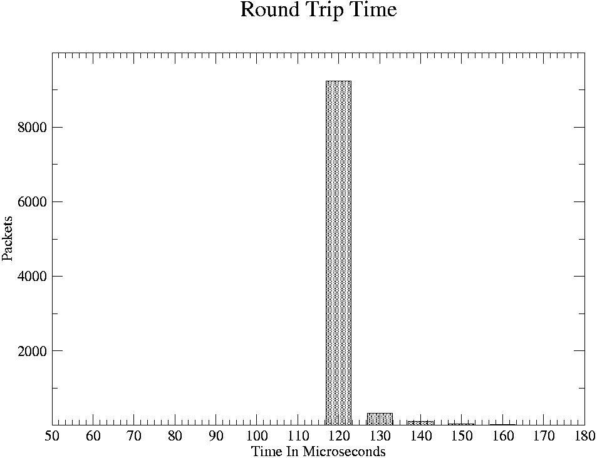
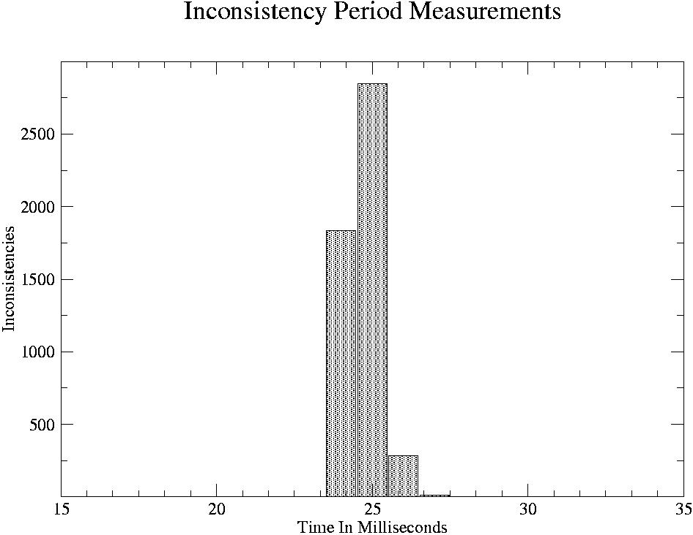
RTT & Inconsistency Period Measurements
RTT: 120 μs
T_{I} = max{T_{U} + T_{S} + R_{i,S}}
MIP = 27 ms

Slide 16
Peer-To-Peer Architecture
Players communicate directly with each other
State consistency requires distributed agreement protocol

Slide 17
PP Bandwidth Requirement
A player sends an update to every other player
A player receives an update from every other player
Bandwidth Requirement:

Slide 18
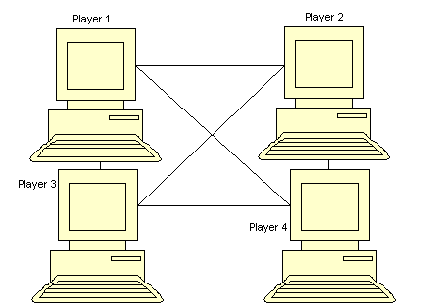
Consistency Resolution in PP
A player i sends an update to all other players
Player j checks if player i’s update is consistent with j’s state
If not, player j sends an update to all players, including player i, invalidating i’s update
MIP:

Slide 19
Peer-to-Peer with Central Arbiter
Players communicate with each other as in PP
Central Arbiter performs three tasks:
Receive updates from all players
Compute new global state
If a player’s update creates an inconsistency, send corrected update to all players

Slide 20
Bandwidth Requirement at PP-CA
Player bandwidth requirement:
Upstream -
Downstream -
Server bandwidth requirement
Upstream -
Downstream -
depends on inconsistency rate
Best Case –
Worst Case -

Slide 21
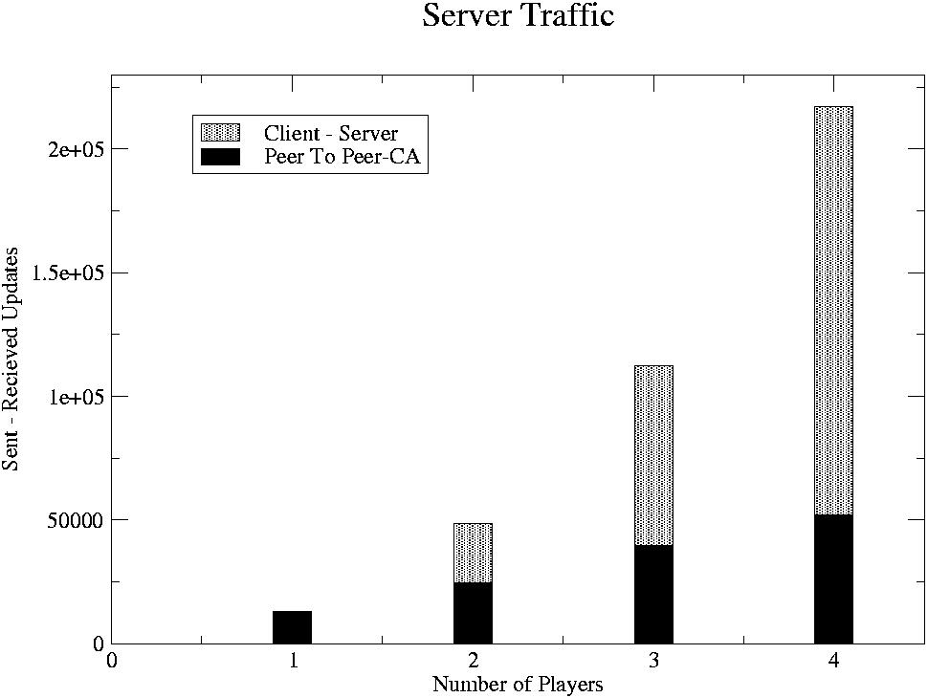
PP-CA Bandwidth Measurements
Inconsistencies: location conflicts
Introduce 50% inconsistency rate

Slide 22
Maximum Inconsistency Period in PP-CA
Inconsistencies detected as in CS model
Same MIP as in CS
T_{I} = max_{i} {T_{U} + T_{CA} + R_{i,CA}}

Slide 23
Conclusions
PP-CA model combines best features of CS and PP models
Lower player-player latency (PP)
Simple state consistency resolution protocol (CS)
Improved bandwidth scalability, as long as state inconsistencies are rare

